Slide 1
Thread Scheduler Efficiency Improvements for Multicore Systems
Daniel Collin Frazier
Division of Science and Mathematics
University of Minnesota, Morris
Morris, Minnesota, USA
18 November 2017
UMM, Minnesota

Slide 2
Introduction
The problem of thread scheduling has been around since the 1960s and for a while, scheduling implementation was largely unchanged
The thread scheduler is an important system component that is always running
The thread scheduler must be as efficient as possible
Reduce time spent doing necessary/maintenance tasks (the critical section)
Increasing hardware requirements in the early 2000s made the problem more complex

Slide 3
“And you have to realize that there are not very many things that have aged as well as the scheduler. Which is just another proof that scheduling is easy.”
Linus Torvalds, 2001 [2]

Slide 4
Overview
Establish needed concepts
Thread scheduling and thread load-balancing on Linux
Bug fixes and two new developments to the Linux thread scheduler

Slide 5
Before we define what thread scheduling is,
let’s get some terms out of the way!

Slide 6
Outline
Establish needed concepts
Threads, Multithreading Programs
Parallel programming
Synchronicity and Locks
Thread scheduling and thread load-balancing on Linux
Bug fixes and two new developments to the Linux thread scheduler

Slide 7
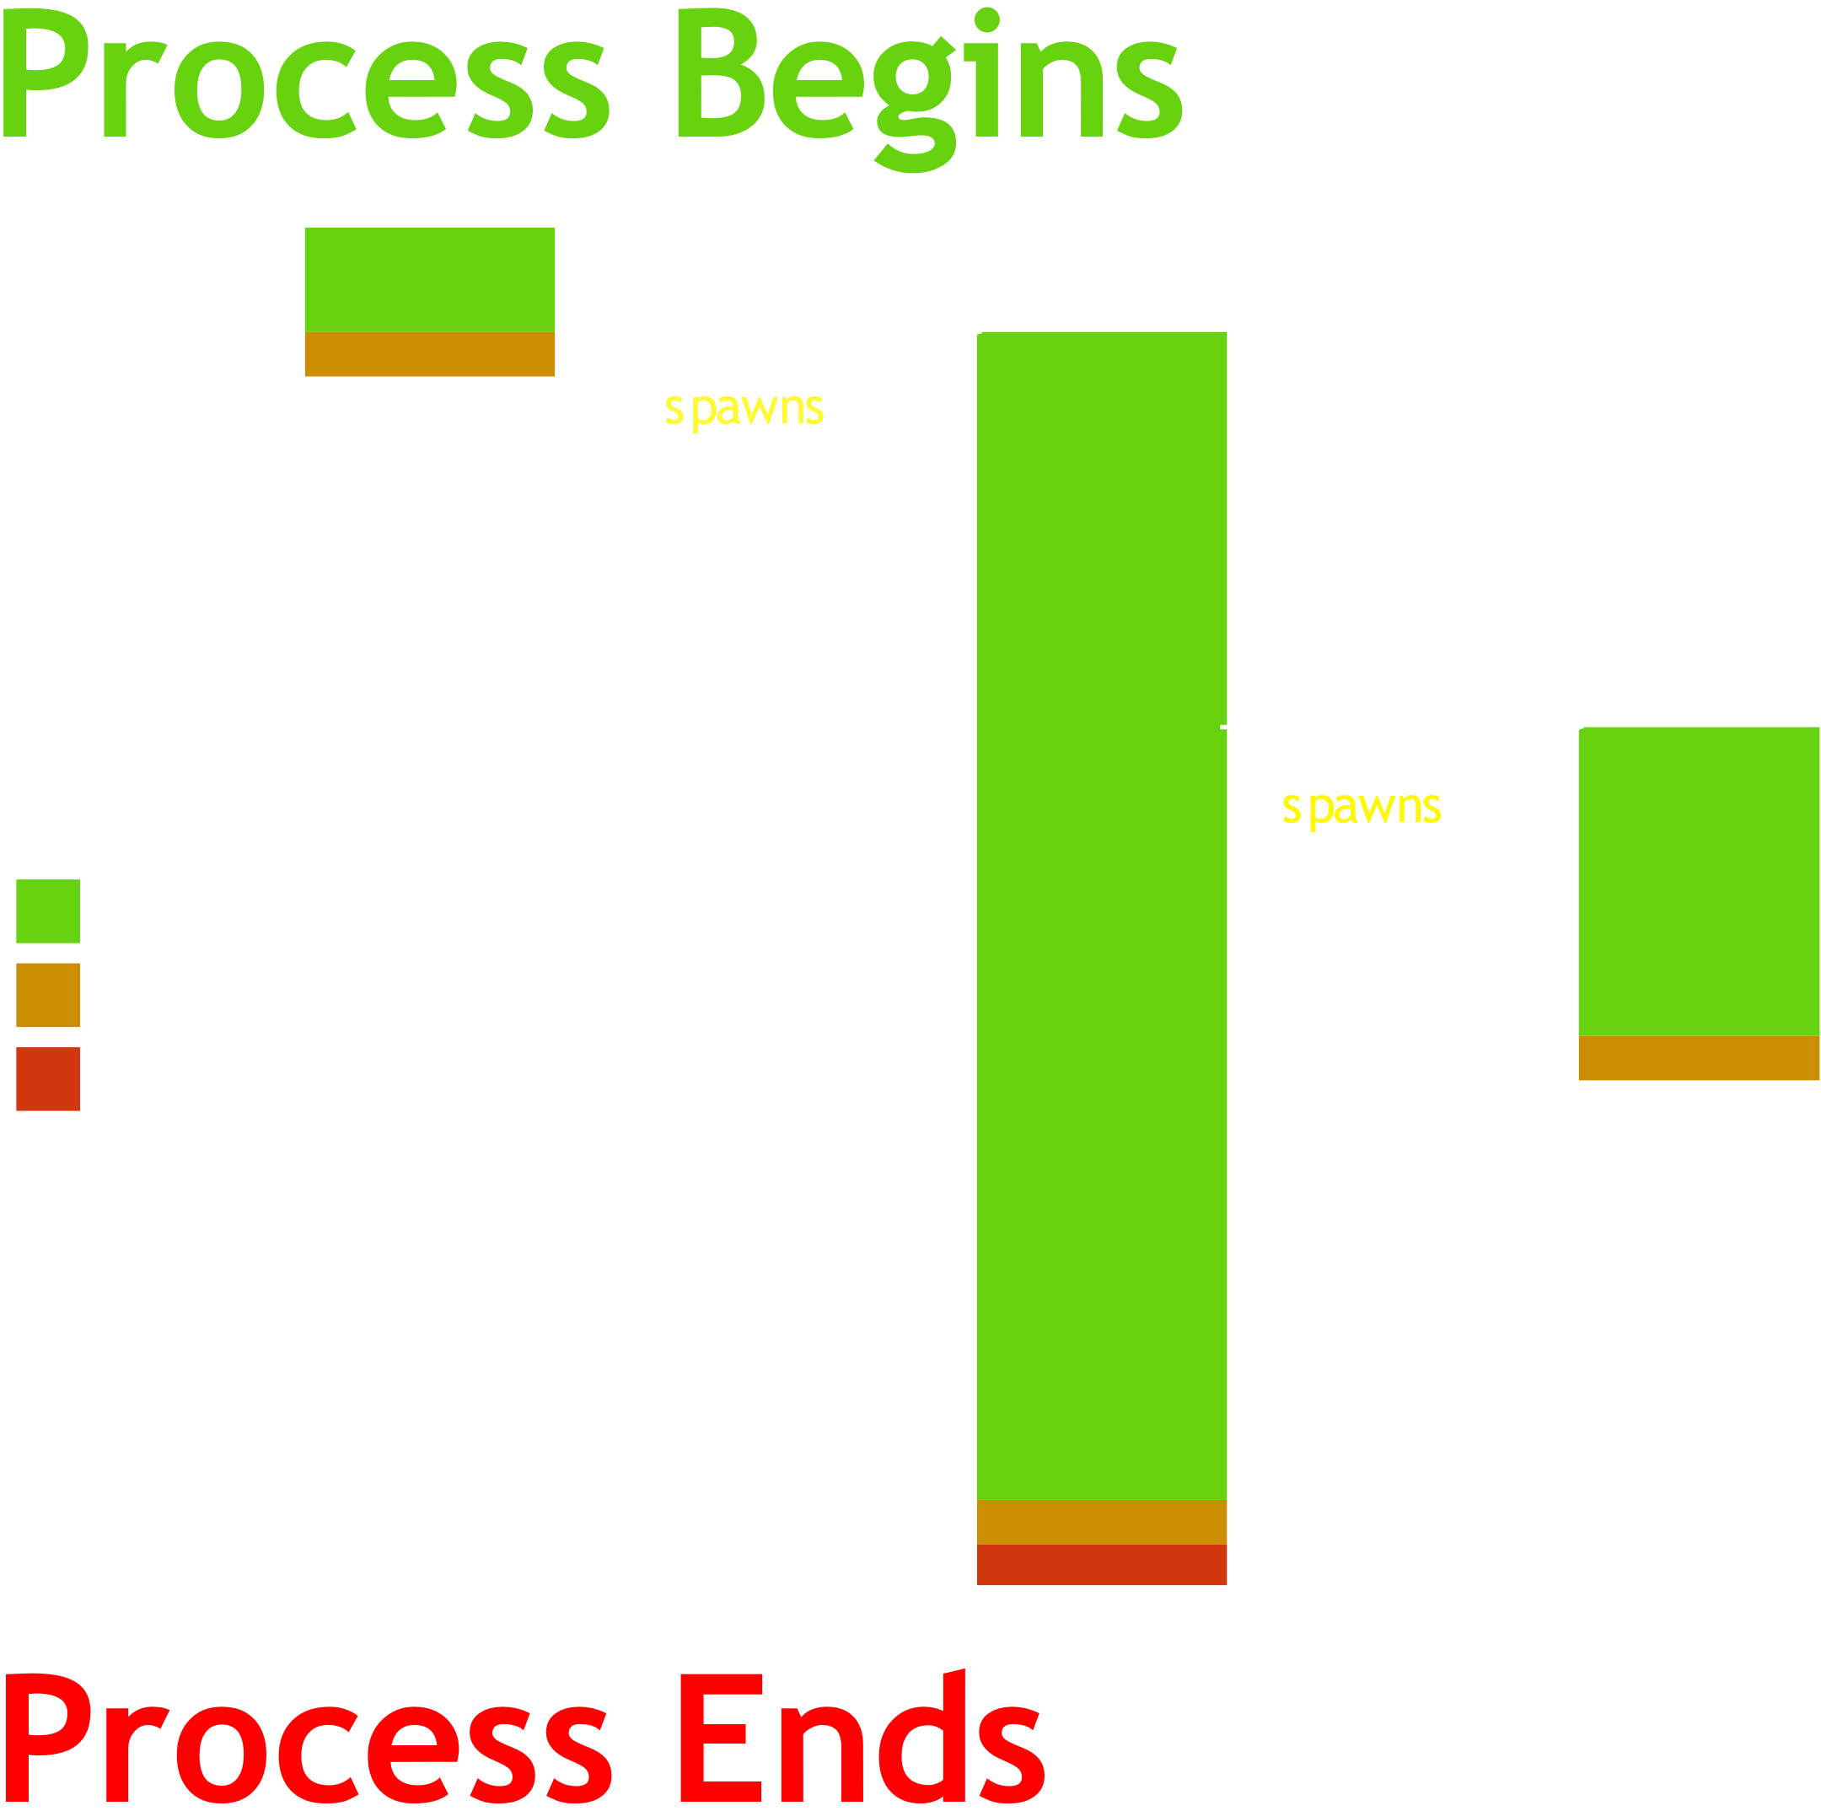
Using Threads
Threads allow a program to run more than one independent task at one time
Useful for…
Programs with long, mostly-independent computations
Programs with graphical interface
Example GUI Program (right)
In this figure there are three Threads created within one Process

Slide 8
Using Threads
A multithreaded program is a program that employs threads
Concurrent computing techniques are techniques that allow many tasks to occur at the same time [W]
Parallel computing techniques are techniques that allow many calculations to occur at the same time [W]
Problems can be solved or improved using none, either or both of these techniques at once

Slide 9
Parallel Programming
[Fill in once I actually know anything about parallel computing]
Don’t go in to detail, high level descriptions.

Slide 10
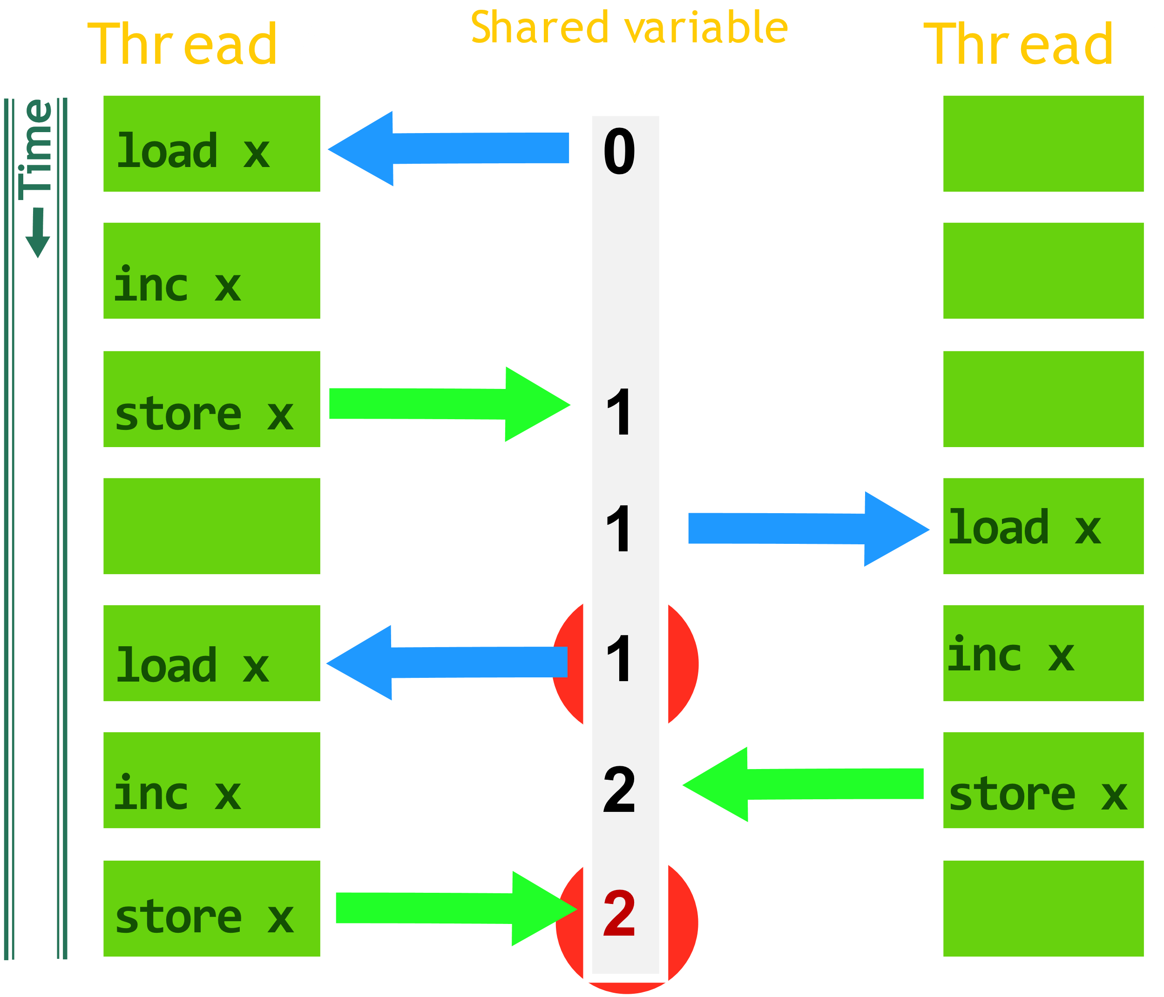
Race Condition (example)

Slide 11
Synchronicity and Locks
Synchronicity can achieved by employing locks
When locks are used properly, they fix race conditions
(Does this count for all abstract “systems”? Does it fix all types of race conditions? The abstract “lock” is engineered to solve race conditions for an abstract “system” right?)
Locks are effectively booleans that are set when using objects or data shared between threads
When a thread sets a lock to locked, that thread “acquires” the lock
When a thread unlocks a lock, that thread “releases” the lock

Slide 12
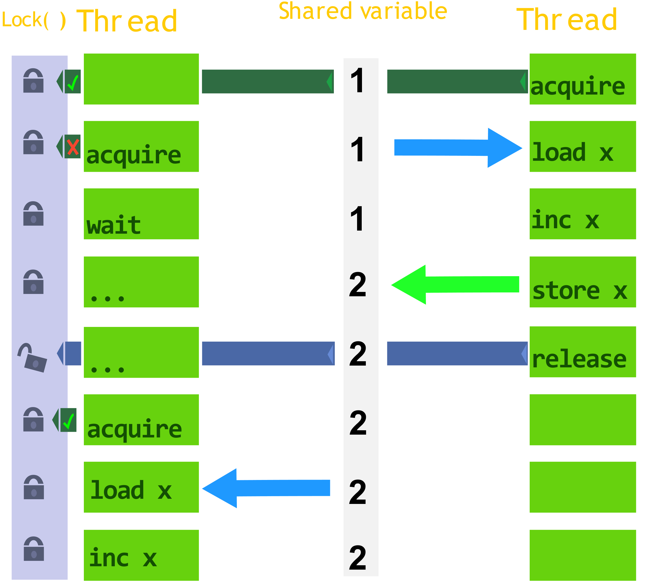
Lock Example

Slide 13
Outline
Establish needed concepts
Thread scheduling and load-balancing on Linux
Completely Fair Scheduler (CFS)
Cache and Scheduling Domains
Load Balance algorithm for the CFS
Bug fixes and two new developments to the Linux thread scheduler

Slide 14
Completely Fair Scheduler (CFS)
Default Linux Thread Scheduler (there are others)
Handles which threads are executed at what times and on which CPU cores
Spend a fair amount of runtime on all threads
The CFS implementation is simple for a single-core system
For now, let’s assume one single core CPU
The scheduler switches active threads by saving and restoring thread and processor state information.
Switching active threads and processes are called context switches.

Slide 15
Process and Thread state
Process
[state info]
Thread
[state info]

Slide 16
Completely Fair Scheduler (CFS)
Implementation of Weighted Fair Queueing (WFQ) scheduling algorithm
Goal: * Run all threads at least once within an arbitrary interval of CPU cycles
* “Timeslice” cycles evenly, prioritizing higher weights
Thread 1
weight=.5
vruntime=3
Thread 2
weight=1
vruntime=10
Thread 3
weight=0.25
vruntime=110
Thread 4
weight=0.5
vruntime=70
Max
Runtime
222
444
112
222
CPU
interval=1000 cycles

Slide 17
Runqueue on One CPU
When a thread is running, it accumulates vruntime
A runqueue is a self organizing Red-Black Tree that sorts on vruntime
New threads are chosen as the leftmost node, with the least vruntime.
CPU
cycles=1000
current thread: Thread 1
Thread 4
weight=0.5
vruntime=70 /222
Thread 2
weight=1
vruntime=10 /444
Thread 3
weight=0.25
vruntime=110 /112
Thread 1
weight=.5
vruntime=3 /222

Slide 18
Multiple Runqueues
Context Switching is expensive across cores
Multicore systems need multiple runqueues to minimize context switches

Slide 19
Outline
Establish needed concepts
Thread scheduling and thread load-balancing on Linux
Bug fixes and two new developments to the Linux thread scheduler
Four bugs found within current implementation of CFS
FLSCHED: The lockless thread scheduler
Shuffler: Cache locality improvements via thread migration

Slide 21
Lock Contention

Slide 22
Conclusions

Slide 23
References
K. Kumar, P. Rajiv, G. Laxmi, and N. Bhuyan. Shuffling: A framework for lock contention aware thread scheduling for multicore multiprocessor systems. In 2014 23rd International Conference on Parallel Architecture and Compilation Techniques (PACT), pages 289–300, Aug 2014.
J.-P. Lozi, B. Lepers, J. Funston, F. Gaud, V. Quéma, and A. Fedorova. The linux scheduler: A decade of wasted cores. In Proceedings of the Eleventh European Conference on Computer Systems, EuroSys ’16, pages 1:1–1:16, New York, NY, USA, 2016. ACM.
U. B. Nisar, M. Aleem, M. A. Iqbal, and N. S. Vo. Jumbler: A lock-contention aware thread scheduler for multi-core parallel machines. In 2017 International Conference on Recent Advances in Signal Processing, Telecommunications Computing (SigTelCom), pages 77–81, Jan 2017.

